Slide 1
Math analysis
Day 21

Slide 2
Objective
Flag Patterns Repeated with Level 3
Create your own pattern using as function calls you haven’t used yet… or expand on the ones that you have

Slide 3
Flag Project (Make sure you are in CHROME and not internet explorer)
In Bricklayer Lite Level 3
Create a Function(s) with a flag of your choice…
Flag’s dimensions must be 16x32 blocks (or 32x16)
Repeat the flag to fill the entire 128x128 grid
Save your flag as Name_Country.xml
Load it onto Teams in the Flag_Project_Formative folder

Slide 4
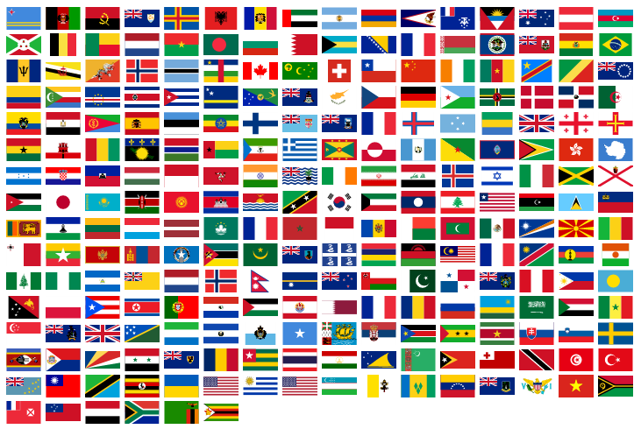
Use functions to create a countries flag…

Slide 5
Review Saving in Bricklayer Lite to Teams
Change “Filename” make sure it ends with .xml
Click Download XML
Open up Teams
Open the appropriate folder: ______________________
Click “upload” and select your recently downloaded file
Save
*Move the file to your Own Drive from your Downloads folder

Slide 6
Make a Second Flag, same rules as before, but pick a more challenging design (or use multiple flags)
In Bricklayer Lite Level 3
Create a Function(s) with a flag of your choice…
Flag’s dimensions must be 16x32 blocks (or 32x16)
Repeat the flag to fill the entire 128x128 grid
Save your flag as 2_Name_Country_Challenge.xml
Load it onto Teams in the Flag_Project_Formative folder

Slide 7
Get Creative… Fill the entire 128x128 grid with a design of your choosing
Things to Explore
Functions inside of functions
Repeat functions
Attempt to use the line function call (not just the put function call)
Explore the shapes function calls
Anything else you haven’t tried yet

